Slide 1
E-Rate Funding
John Jones President Efibernet, Inc.
256 945-7799 or 256 924-5715
johnjones@efibernet.com
Ms. Tonya Campbell
Greater Atlanta Adventist Academy & Berean Christian Junior Academy
E-RATE Administrator

Slide 2
Conception of E-RATE
The Federal Communication Commission (FCC) established a non-profit corporation in 1997 called the Universal Service Administrative Company (USAC) to collect funds from telecommunications carriers create support programs that help communities across the countries obtain access to affordable telecommunication services.

Slide 3
Poll Questions
Has your school or district applied for E-rate before?
Yes
No
If yes, which category of funding have you applied for in the past?
Cat 1
Cat 2
Both
How familiar are you with FCC E-rate modernization?
Not at all
Somewhat
Completely

Slide 4
The Funds
The FCC – Regulatory Fees
cell phones
Home phones
Electronic devices
Mandate: Allocated only for the use of establishing internet and telecommunications.

Slide 5
E-rate (Schools and Libraries)
The Schools and Libraries Program, commonly known as E-rate, provides discounts to help schools and libraries obtain affordable rates for telecommunications services, Internet Access, internal connections, and basic Maintenance of internal connections. The program is Administered by USAC under the oversight of the FCC.
$3.90 billion in funding annually (including recent $1.5B increase) 2015
Over $7 Billion – 2017 (Congress established $5 billion in addition)
Available to K-12 schools and Libraries
Eligible products and services include:
Telecommunication services & Internet Access (Category 1)
Internal connections and maintenance (Category 2)
Category 1 Discount (Funding) ranges from 20%-90%;
Category 2 Discounts 20%-85%
Determined by National School Lunch Program participation
Greatest need funded first (90%/85%)

Slide 6
E-rate Modernization
Recent changes mark the first major update to the E-rate program in its 17 year history
Streamlines the process for multi-year applications.
Expedites process for small dollar, cost-effective applications.
Speeds review of all applications.
Moves to electronic filing of all documents.
New funding guidelines beginning with 2015-16 school year
Focus on improving rural broadband access and Wi-Fi networks in schools and libraries
Allows support for Wi-Fi purchased as a managed service (CAT 2)
$5B in Wi-Fi funding for 5 years beginning 2015 school year

Slide 7
E-rate Deadlines
Form 470 (Application for Request) July 2015 – February 2016
First form that must be filed by a school or library in the E-rate application process
Primary purpose is to briefly describe the applicant, provide a point of contact, and indicate any new telecommunications and technology services that the applicant will be seeking
Form 471 (Funding Request) – March 2016
Second form - Specific discount requests
Form 470 must be received and posted on Web site for at least 28 days

Slide 8
Our WLAN is Under Enormous Pressure
More APs
More Coverage
More Users
More Apps
More Devices
More Traffic
More Locations

Slide 9
Classroom Transformation
Mobility has transformed the classroom
Proliferation of mobile devices
89% of high schools students have access to a smartphone (SpeakUp 2013 National Findings)
8 million iPads sold directly to educational institutions worldwide (Feb 2013, TechCrunch article)
Enables collaboration, interaction, and more …
Over 75,000 educational apps (Apple press release, Jun 2014)
Google for research
Smartphones as student-response systems
Facebook and Twitter for collaboration
Homework/Assignment portals & servers
Over 70% of school districts in SpeakUp 2013 National Findings: K-12 principals believe school-wide Internet would be the technology that would have the greatest impact on improving learning.”

Slide 10
Curriculum Built Around Devices
E-Textbooks
Apple’s iBooks
Over 2,500 classrooms using iBooks
Over 80% of core curriculum in US high schools covered by iBooks (readwrite.com article, Oct 2012)
Video Content
YouTube for Education
School-appropriate
Teacher-Friendly
iTunes U
Over 1 billion course downloads,
1,200 universities, 1,200 school districts courseware (Apple press release, 2013)
Government Initiatives
PARCC and Common Core Testing
State Mandates around e-Books
FCC’s Digital Textbook Playbook
While the United States spends more than $7 billion a year on textbooks, too many students are using books that are 7-10 years old with outdated material
FCC’s Digital Textbook Playbook: fcc.gov/document/fact-sheet-digital-textbook-playbook
Notes:
Mobility is also transforming curriculum.
E-Textbooks are emerging to take advantage of the interactive capabilities of tablets and iPads. Apple’s initiative around iBooks adds momentum to creating and delivering e-textbooks.
http://readwrite.com/2012/10/23/ibooks-refresh-makes-it-easier-to-tweet-50-shades-passages
Video, which has been key to digital learning is also growing. YouTube has recently launched YouTube for EDU – a specialized channel for schools and teachers. Apple’s iTunes U has experienced tremendous growth and recently topped 1 billion downloads of courseware.
Lastly, government initiatives are driving the growth of electronic curriculum. The Federal Communications Commission has published a “Digital Textbook Playbook” on how to benefit from and implement e-textbooks in schools. “A ROADMAP FOR EDUCATORS TO ACCELERATE THE TRANSITION TO DIGITAL TEXTBOOKS ISSUES CHALLENGE TO STATES AND COMPANIES TO ENSURE EVERY K-12 STUDENT HAS A DIGITAL TEXTBOOK WITHIN FIVE YEARS“
States like California, Florida, Texas, West Virginia, Maine and Virginia have rolled out programs and incentives to push e-textbooks.

Slide 11
Impact of Mobility on the LAN
Need for Anytime, Anywhere Access From Any Device
Scalable Network
Twice the number of users
2-3 devices per user
Higher Bandwidth
E-textbooks, video streaming
Online test services, homework servers
Cloud-based applications
Wider Coverage
Entire campus or school district
High traffic areas
Auditorium, cafeterias, gyms, etc.
Security at the edge
Endpoints security
RF-Intrusion Detection
“BYOD makes 1-1 easier by simply leveraging the devices they already have, or those their parents can buy for them.”
The NMC Horizon Report: 2014 K-12 Edition
Notes:
BYOD drives the need for anytime anywhere access from any mobile device. However, your school’s wireless networks will be tested from four fronts.
The first is need for a scalable network. With BYOD, all of a sudden you have to deal with twice as many users competing for access to your Wi-Fi network. And demands on your wireless network will grow as it’s common for students and staff to carry three or more mobile devices.
The second is applications that require higher bandwidth. The move to e-Textbooks, YouTube videos, online testing and other cloud-based applications require high-bandwidth always-on access to access.
The third is need for wider coverage. Earlier, offering Wi-Fi coverage in a few class rooms or the conference room and the lobby was enough. Today you need wider wireless coverage – the whole building, across the campus or even the across the school district. At the same time, you need to maintain persistent IP sessions for students who may be moving from one floor to the next or walking across the campus, and need uninterrupted access to the network.
And finally, you need to secure your network. With BYOD, you need to ensure the mobile devices that students and faculty are bringing in comply with your current security and authentication policies. At the same time, you need to ensure security over the air to detect and isolate threats from rogue APs and other malicious threats.
All this is happening right now, and is placing incredible pressure on your wireless network.

Slide 12
IT Priorities
Enable Mobility to Support BYOD, Online Testing and eBooks
Upgrade wireless LAN infrastructure within schools and classrooms
Centralize user and security policy administration to support BYOD and 1-1 initiatives
Support High-bandwidth Applications and Access Devices
Upgrade LAN infrastructure to support digital learning content, video streaming, VoIP, and IP surveillance
Scale to support growing number of PoE-powered endpoints - wireless APs, IP phones, IP security cameras, etc.
Enhance cabling infrastructure
Legacy cabling infrastructure does not support voice and data applications
Quickly resolve connectivity issues for staff and students
Enhance network reliability and ensure business continuity
Re-cabling is both expensive and causes disruption to learning environment
Notes:
These trends are resulting in new challenges that K-12 IT managers need to consider.
ENABLING MOBILITY
BYOD and 1-1 Computing initiatives are driving the need for enabling mobility in schools. Enabling mobility in schools requires:
Providing anytime, anywhere access to school resources from any mobile device. School districts need to consider a wireless LAN solution that can scale to support multiple devices per user, as well as provide bandwidth to support the rapidly growing digital content.
Seamless user access: In addition, you need to consider solutions that can support users entering the network through wired or wireless access to offer seamless access to all users.
device of their choice.
- Centralized policy management and enforcement allows users to sign-in gaining access to enterprise resources anywhere in the world. With Centralized management, IT managers can also ensure consistent user access policies, traffic management and security policies.
CLOUD CONNECTIVITY
As the shift to the cloud occurs, connectivity to cloud-based resources is key determining the effectiveness of how the school district is leveraging cloud resources. Key considerations include for an effective cloud connectivity solutions include:
- High Performance, Secure and Reliable Solutions: These are critical areas of focus for K-12 IT departments when looking at their Cloud connection knowing that potentially sensitive student and staff data will be hosted in the cloud.
- Support for District-wide Connectivity: The days of a stand-alone solutions for a single school are gone. As school districts continue to centralize IT management, IT managers need to consider solutions for multiple scenarios – public cloud connectivity for all schools; a secure private cloud connection between schools and the district headquarters; and high-bandwidth LAN solutions within schools and classrooms. The ability to support district-wide cloud connectivity with a single vendor solution offering can greatly simplify ongoing administration and support.
- Business Continuity: A great question every IT professional should have when moving business critical applications to the cloud is, “What happens when my connectivity fails?”
UNIFIED COMMUNICATIONS
While deploying Unified Communications, IT managers are looking to empower faculty and staff to become more efficient and capable. With this in mind, the key UC considerations include:
- Enhancing Staff Productivity: Empowering administrators, teachers, and staff to do more in today’s challenging educational environment can make a huge difference in the experience of those you serve.
- Mobile Device Support: Many estimates today state that the average employee utilizes up to three different WiFi enabled devices, and enterprises need a plan to support these without overburdening their network.
- Simplification: With many vendors playing in niche technologies, educational institutions should look to complete solution providers for simplifying growth and support.

Slide 13
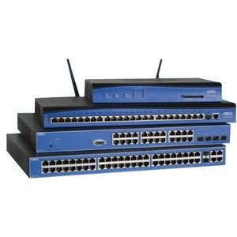
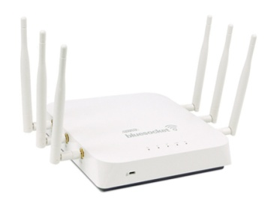
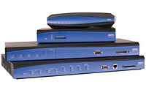
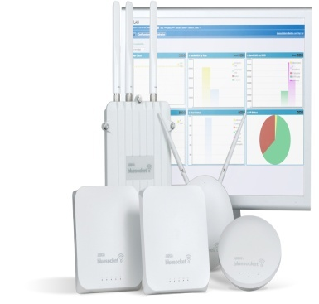
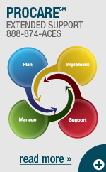
ADTRAN E-rate Eligible Solutions Cat 2
Access Points (a/b/g/n/ac
Routers
Switches
ProStart
ProCloud
ProCare

Slide 14
Flexible Cloud-based Deployment Options
Choose Your Cloud
Hosted & Managed Cloud
Fully Managed and Hosted
Redundancy
Guaranteed SLA Uptime
Private Cloud
School Managed
and the Freedom to Migrate Between Them
Hosted Cloud
By Frontier
VMware Virtual Appliance or Hardware Appliance
Hosted but managed by Frontier

Slide 15
Summary
New E-rate funding has opened the gates to affordably build out Wi-Fi networks in K-12 schools and libraries
ADTRAN understands the ever changing environment of school’s IT needs and provides solutions that can scale, evolve and migrate as needed
ProCloud offers a “Worry Free” managed Wi-Fi service option for K-12 schools and libraries that can’t be matched
ADTRAN has networking solutions to power your LAN, WLAN and VOIP network

Slide 16
E-RATE
Thank You

