Slide 1
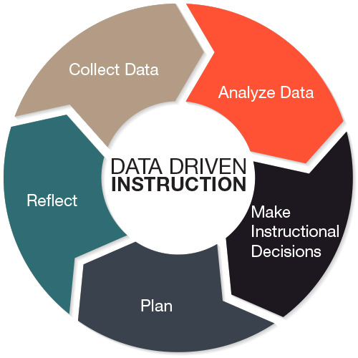
South Atlantic Conference of Seventh-day Adventists
Office of Education
Using Data Driven Instruction to Pick Up the Pace

Slide 2
South Atlantic Conference of Seventh-day Adventists
Office of Education
Using Data Driven Instruction to Pick up the Pace
“If it’s a matter of being bothered, and no one is willing to give you a satisfactory explanation, why bother doing that thing at all.” - Eeyore

Slide 3
South Atlantic Conference of Seventh-day Adventists
Office of Education
Using Data Driven Instruction to Pick up the Pace
Presentation Goals…
As a result of this workshop, you will:
Better understand data-driven instruction as a best practice coupled with differentiation.
Understand the next steps that your school should take to implement this best practice.

Slide 4
South Atlantic Conference of Seventh-day Adventists
Office of Education
Using Data Driven Instruction to Pick up the Pace
Discussion: Read the quote below:
True education takes a high, broad view. It is not low and narrow. It is focused on the whole being, mentally, spiritually, physically, [emotionally] (White, 1910).
Do you agree or disagree with this statement? Why?
4

Slide 5
South Atlantic Conference of Seventh-day Adventists
Office of Education
Using Data Driven Instruction to Pick up the Pace
A Cause for Alarm
Only 30% of Adventist students attend an Adventist school. We need to build a better, stronger, faster, more competitive program.
More than 8 million students from grades 4-12 are reluctant/at-risk. They include Adventist children.
More than 3,000 students drop out of American schools each day. We can expect some to be Adventist.
Only 70% of American high school graduates graduate with a regular diploma; yes, some are Adventist.
The lowest achieving 25% are most likely to drop out.
53% of college-bound high school students must enroll in remedial college classes, including Adventist students.

Slide 6
South Atlantic Conference of Seventh-day Adventists
Office of Education
Using Data Driven Instruction to Pick up the Pace
Close your eyes
Think about the students who are about to walk into your classroom.
Think about what they are going to learn in your room this year.
Think about the group of students who are going to struggle under your instruction.
What do they need to do?
Think about what you need to do to make their experience a success.
Now think about one student in that group who will struggle the most.
What are you going to do to help that student achieve?
Now bring the small group back into focus. What are they accomplishing in your classroom right now?
Now bring the larger group back into focus. What are they accomplishing while you are helping a small group achieve?
Open your eyes.
You have one minute to talk with a partner. Tell them what you were experiencing emotionally and professionally. They will have one minute to respond to you, and then one minute to share with you what they felt, then you will respond to them.
Your first of four minutes begins now.

Slide 7
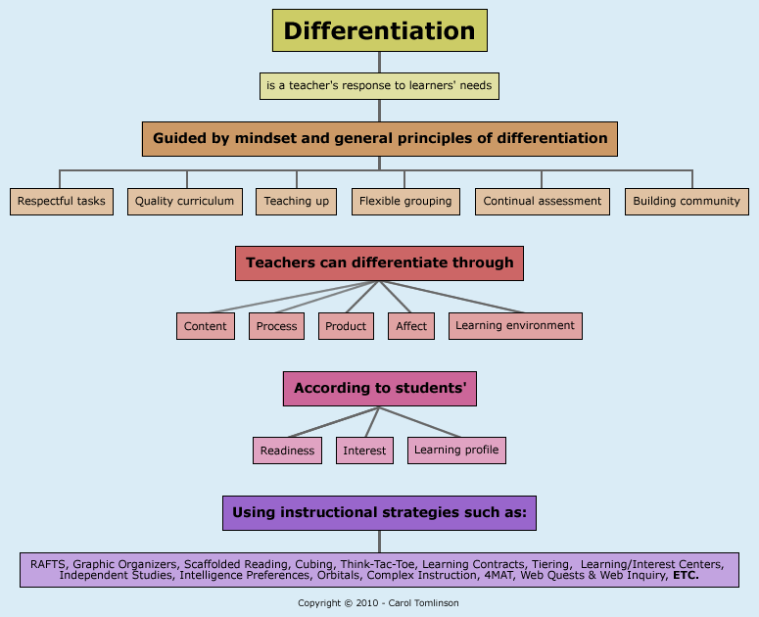
South Atlantic Conference of Seventh-day Adventists
Office of Education
Using Data Driven Instruction to Pick up the Pace
Data must drive instruction to enable the teacher to differentiate the instruction. Differentiation

Slide 8
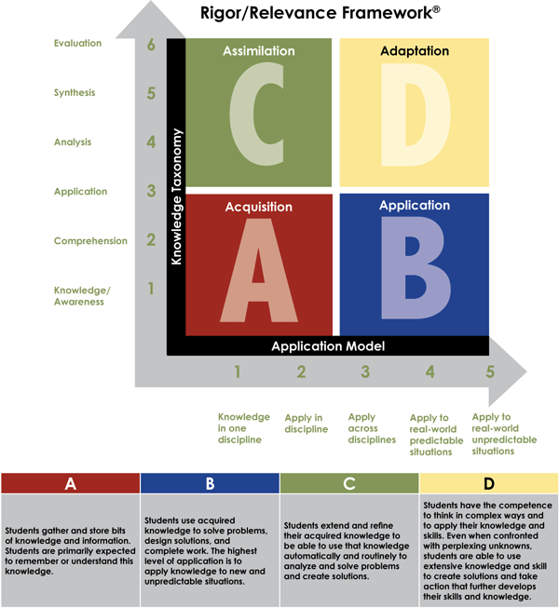
South Atlantic Conference of Seventh-day Adventists
Office of Education
Using Data Driven Instruction to Pick up the Pace
Bill Daggett, 2016

Slide 9
South Atlantic Conference of Seventh-day Adventists
Office of Education
Using Data Driven Instruction to Pick up the Pace
Less often
Summative State Assessments
Formative Common Assessments
Formative Classroom Assessments
Demographics and Perceptions
Benchmark Assessments
More often
adapted from The Data Coach’s Guide to Improving Learning for All Students, p. 129

Slide 10
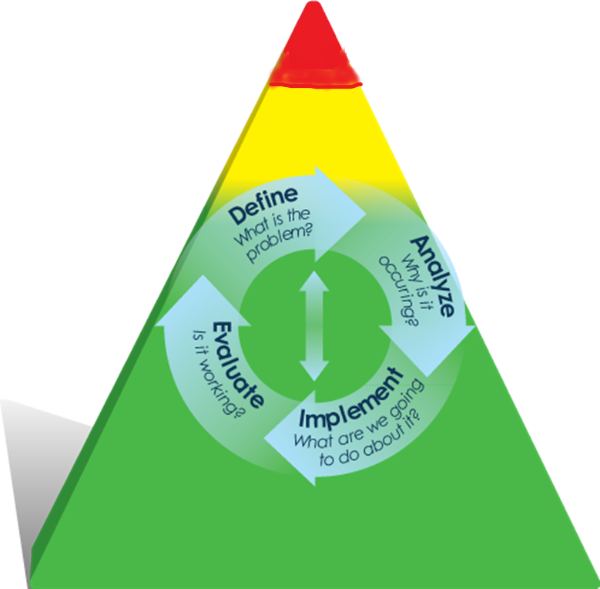
South Atlantic Conference of Seventh-day Adventists
Office of Education
Using Data Driven Instruction to Pick up the Pace
The Universal Continuum:
Chart all student progress.
Analyze needs - strengths/obstacles to achievement.
Identify strategies to be used within the core curriculum or school-wide behavioral support plan.
Core curriculum includes a constructivism-at-work approach: A. Whole Group. B. Small, Differentiated Groups. C. Individualized instruction.
Identify further strategies for core instruction or the school-wide behavioral support plan.
Intensive Intervention
Targeted Intervention
Universal Level Continuum Core Instruction and Behavioral Expectations

Slide 11
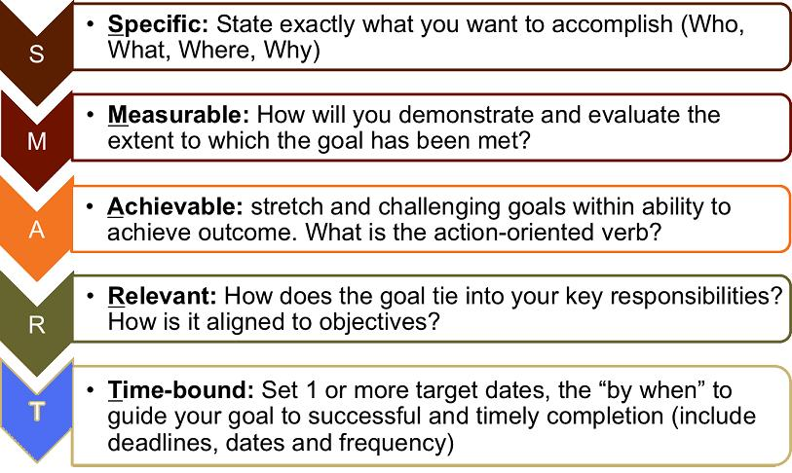
South Atlantic Conference of Seventh-day Adventists
Office of Education
Using Data Driven Instruction to Pick up the Pace

Slide 12
South Atlantic Conference of Seventh-day Adventists
Office of Education
Using Data Driven Instruction to Pick up the Pace
Data Driven Instruction is A Product of Leadership:
Standardizing expectations system-wide
Standardizing tools and protocols
Facilitating fast and accurate communication
Enabling professional evaluation and accountability
Establish school-wide goals of accountability and success
Picking Up the Pace

Slide 13
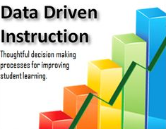
South Atlantic Conference of Seventh-day Adventists
Office of Education
Using Data Driven Instruction to Pick up the Pace
5-Minute Table Talk
What are some strategies you have put in place in your building or at the Conference level to use data to drive instruction?
With your table group, create a graphic organizer to describe effective strategies your school is using.

Slide 14
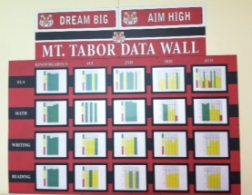
South Atlantic Conference of Seventh-day Adventists
Office of Education
Using Data Driven Instruction to Pick up the Pace
Best Practice Strategies for Using Data to Drive Instruction
Use Curriculum-based Measurement data to create quarterly or trimesterly public displays of data in your school.
Use Student Growth Objectives trimesterly to drive instructional conversations between teachers and administration, asking teachers to cite data indicating how they gauge student learning.
Ask students to quantify and monitor their learning progress.
Use charts and graphs to reduce data to useful information by focusing on simple numbers, gap comparisons, and trends.
Create a School Performance Framework and School Growth Model to chart on-going progress, stagnation, or regression.

Slide 15
South Atlantic Conference of Seventh-day Adventists
Office of Education
Using Data Driven Instruction to Pick up the Pace
Building Data Processes
Use building data to develop a school improvement plan that focuses on a limited number of strategies aligned to the Conference’s goals and strategies.
Determine specific shared instructional strategies to implement school-wide.
Actively monitor the implementation and the effectiveness of the shared instructional strategies (adult indicators) and their impact on student learning.
System or school provides professional development related to Conference goals and initiatives.
Teachers actively participate, assimilate professional development learning.
Principals follow up on implementation.
Make adjustments to the school improvement plan.

Slide 16
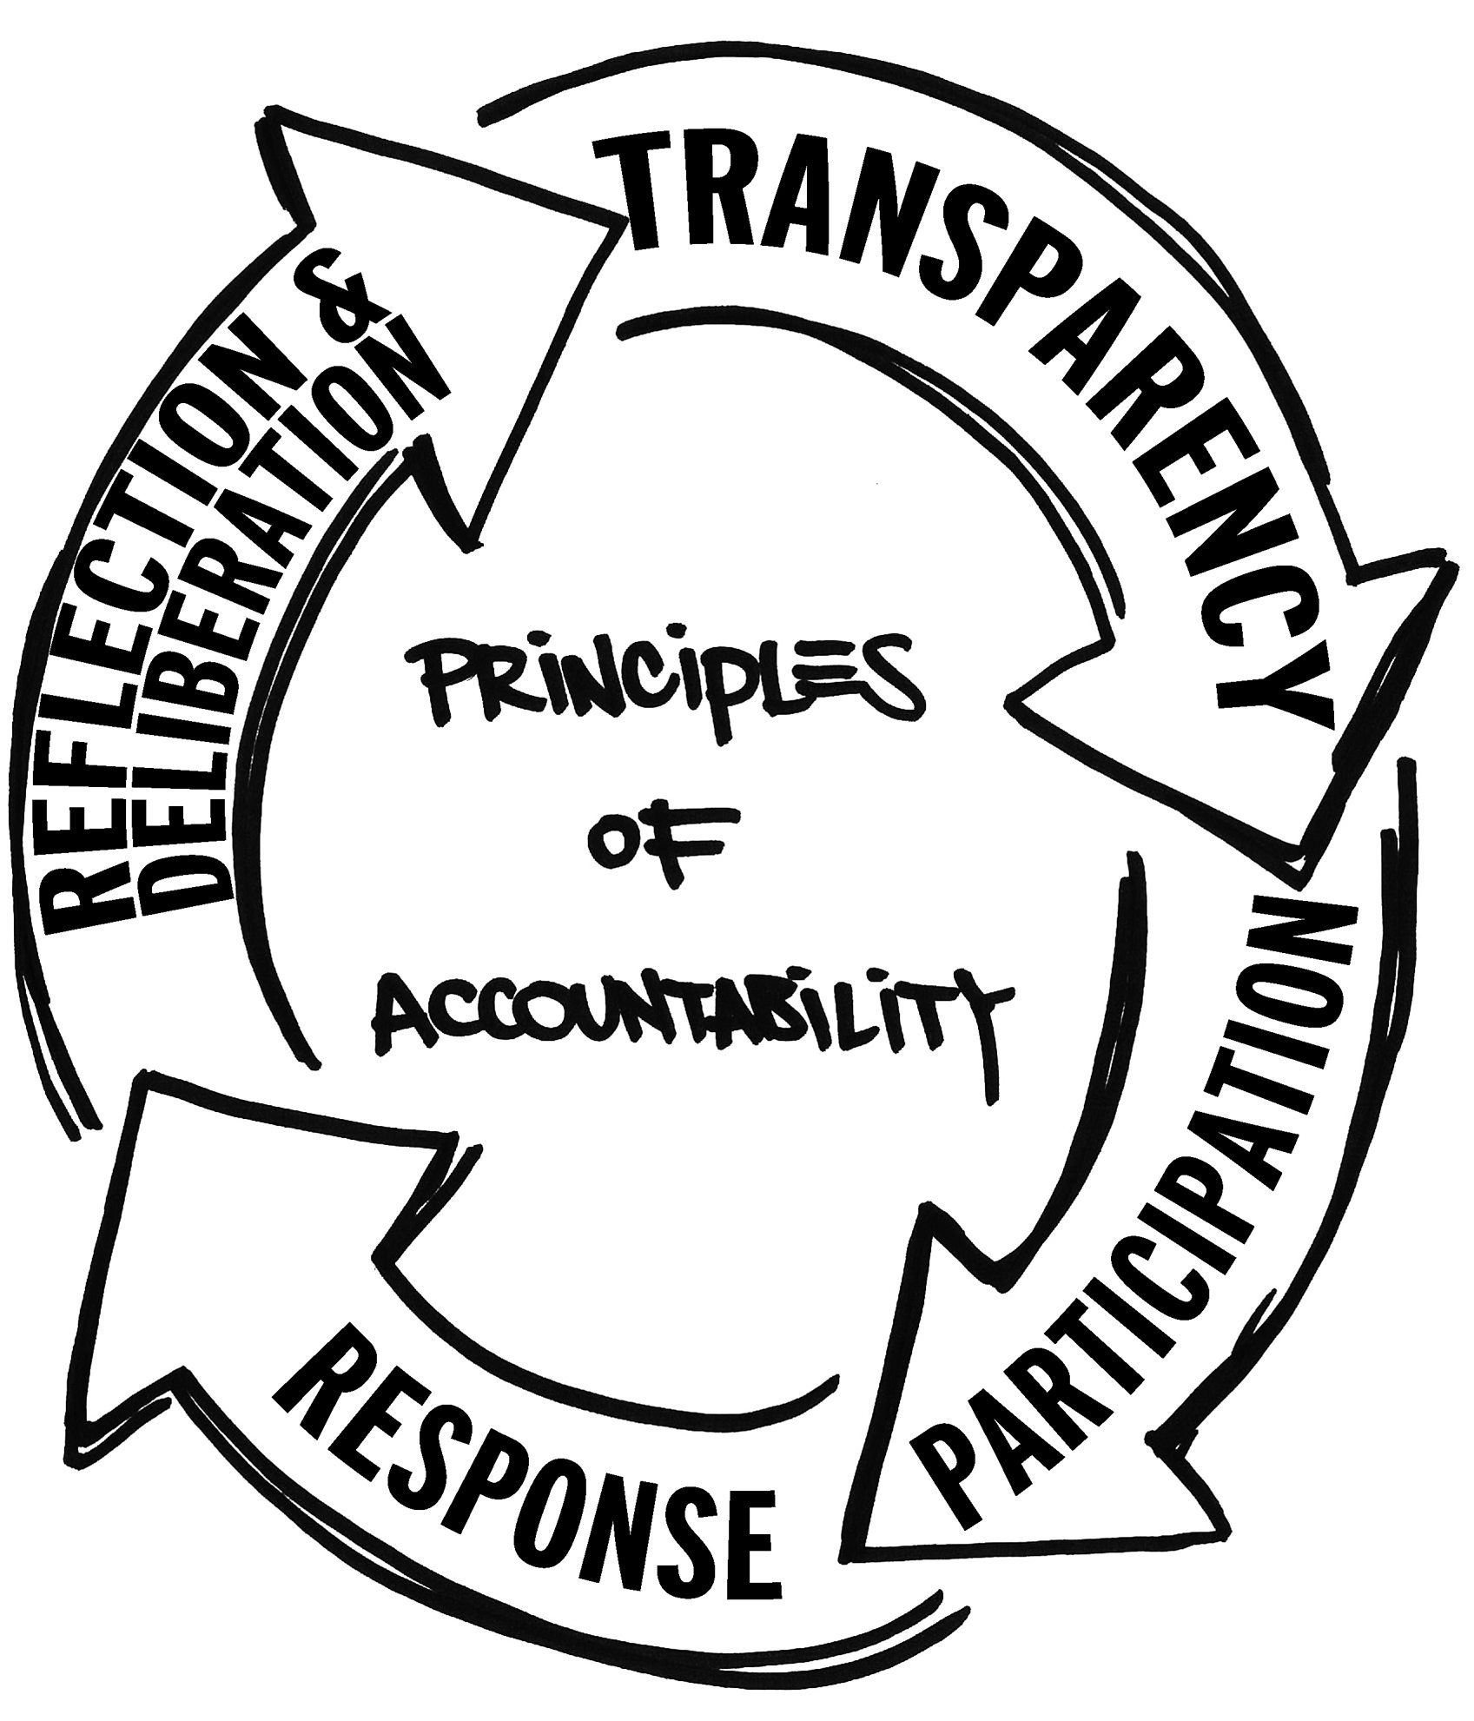
South Atlantic Conference of Seventh-day Adventists
Office of Education
Using Data Driven Instruction to Pick up the Pace
Making Data Public
What goal were we trying to meet with this change?
What data established the need for this change?
What data will prove that we succeeded?
Does this change match the values in our mission?

Slide 17
South Atlantic Conference of Seventh-day Adventists
Office of Education
Using Data Driven Instruction to Pick up the Pace

Slide 18
South Atlantic Conference of Seventh-day Adventists
Office of Education
Using Data Driven Instruction to Pick up the Pace

